Slide 1
Anatomy & Physiology for Health & Social Care
UNIT 4
LO1
Cardiovascular system

Slide 2

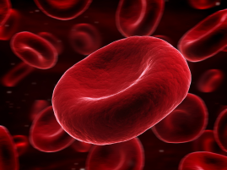
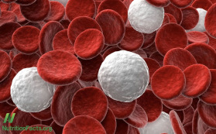
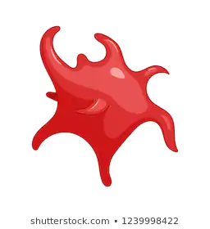
LO1: The Cardiovascular system, malfunctions and their impact on individuals.
Haemoglobin – a red protein responsible for transporting oxygen in the blood.
Immune system – the organs an processes of the body that help defend against and provide resistant to infection.
Cardiovascular system – Cardio means heart and vascular means blood vessels. The heart pump blood around the body, transported by blood vessels.
Exam Tip:
Make sure you memorise the components in the table and you can state their functions.
Component | Function
Erythocytes (red blood cells) | Transport oxygen and carbon dioxide within the body. Don’t have a nucleus, this increases space to carry the maximum amount of haemoglobin. Haemoglobin combines with oxygen, to erythrocytes can transport more oxygen. They have surface area for exposure to oxygen. Small and flexible, allowing them to get into narrow blood vessels and capillaries.
Leucocytes (white blood cells) | Cells that have a role in defence and immunity. Detect abnormal material and destroy it.
Lymphocytes | B-cells produce antibodies to destroy antigens(micro-organisms) like bacteria, viruses and toxins. T-cells destroy the body’s own cells that have been taken over by viruses or have become cancerous.
Neutrophils | Protect the body against bacterial infection. Highly mobile and attracted to any area of infection by chemicals produced by damaged cells.
Monocytes | Part of the immune system. Originally formed in the bone marrow, they are released into the blood and tissues. When certain bacteria enter the body, they rush to the site for attack.
Platelets | Help form blood clots by clumping together, to slow or stop bleeding and to help wounds heal.
Plasma | Liquid in which the blood cells are suspended. Provides a means of transport or glucose, lipids, amino acids, hormones, dissolved food molecules, carbon dioxide and oxygen. Carries proteins including fibrinogen, which helps clotting. Helps with temperature regulation of the body – blood removes heat from tissues such as muscles and circulates around the body.
Composition of blood:
Erythocytes (red blood cells) – made of bone marrow and red due to haemoglobin. They have a thin disc-like shape.
Leucocytes (white blood cells) part of the body’s immune system and are immune cells that defend the body against infections.
The different types of leucocytes are:
Lymphocytes: there are 2 types, B-cells and T-cells. These are white blood cells that are part of the immune system. B-cells develop bone marrow and T-cells develop in the thymus gland. They have wide ranging functions in the immune system.
Neutrophils – these are small and fast; they are one of the first cell types to travel to the site of an infection.
Monocytes – these are the largest of the white blood cells.
Platelets – produced in the bone marrow and are fragments of larger cells, they are disc shaped.
Plasma – largest component of blood, makes up about 55% of blood volume. It’s a clear yellowy-coloured liquid. It carries platelets, red and white blood cells and proteins.
Erythocyte
(red blood cell)
Leucocyte
(white blood cell)
Platelet
(thrombocyte)

Slide 3
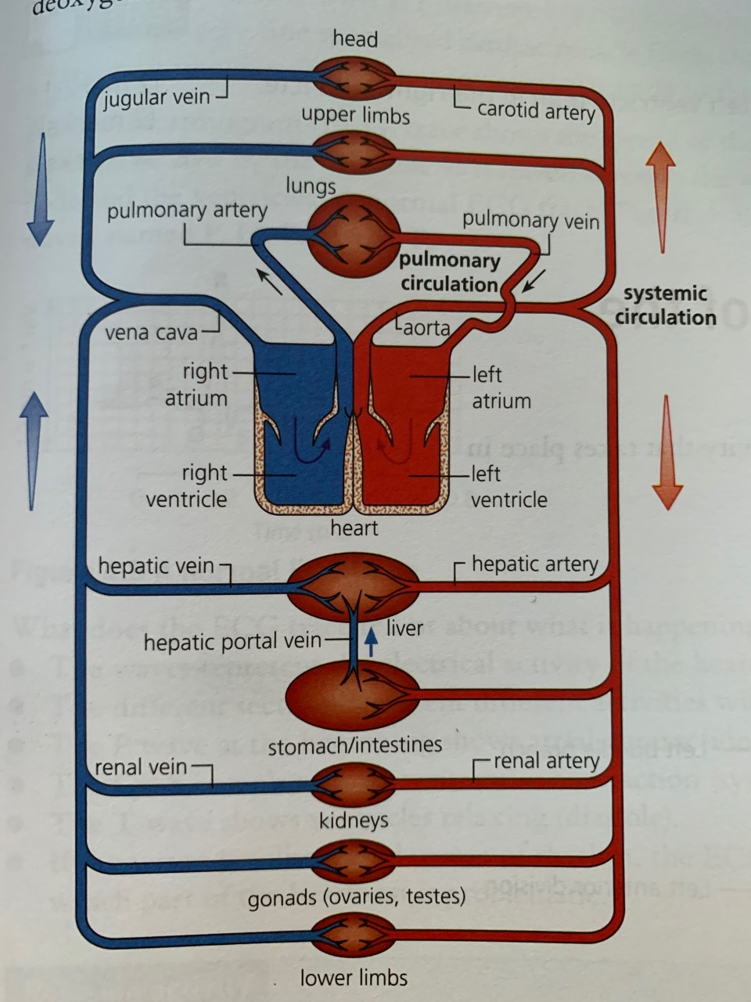
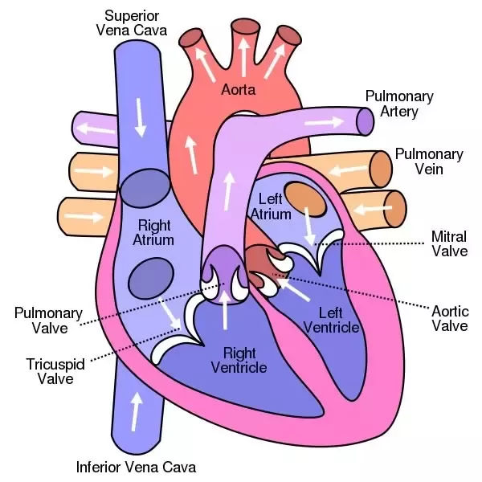
Structure of the heart
Function of the heart
The heart is sometimes referred to as a double pump. It pumps blood through two separate circulatory systems, the pulmonary and the systemic circulation:
Pulmonary – the right side od the heart receives deoxygentated blood from the body and pumps it to the lungs.
Systemic – the left side of the heart receives oxygenated blood from the lungs and pumps to the rest of the body.
The heart is made up from specialized cardiac muscle that does not tire like other muscles in the body.
The heart is split into 4 chambers:
Two upper chambers are called the right and left ventricles. The left ventricle has the thickest muscular wall as it has to pump blood from the heart to the rest of the body.
Blood flows through the heart as follows:
Blood from the lungs, which is oxygenated, returns to the heart via the pulmonary vein and enters the left atrium.
Blood passes through the bicuspid (mitral) valve into the lest ventricle.
Blood is forced out of the aorta and carries oxygenated blood to the rest of the body.
Deoxygenated blood returns from the body to the right atrium via the superior and inferior vena cava.
The blood is then squeezed through the tricuspid valve into the right ventricle.
Blood is forced through the pulmonary artery, which carries the deoxygenated blood to the lungs.
Exam tip – make sure you know the correct names and position of the main parts in the diagram. It will help you get full marks if you have to label a diagram of the heart.
The structure of the human heart.
Cardiac muscle
Each of the four chambers has a major blood vessel entering or leaving it.
Aorta – this is the main artery of the body; it leaves the heart from the left ventricle.
Pulmonary artery – carries deoxygenated blood from the heart to the lungs.
Vena cava – the superior (anterior) vena cava is one of the largest veins in the body.
Pulmonary vein – carries oxygenated blood from the lungs to the left atrium of the heart.

Slide 4
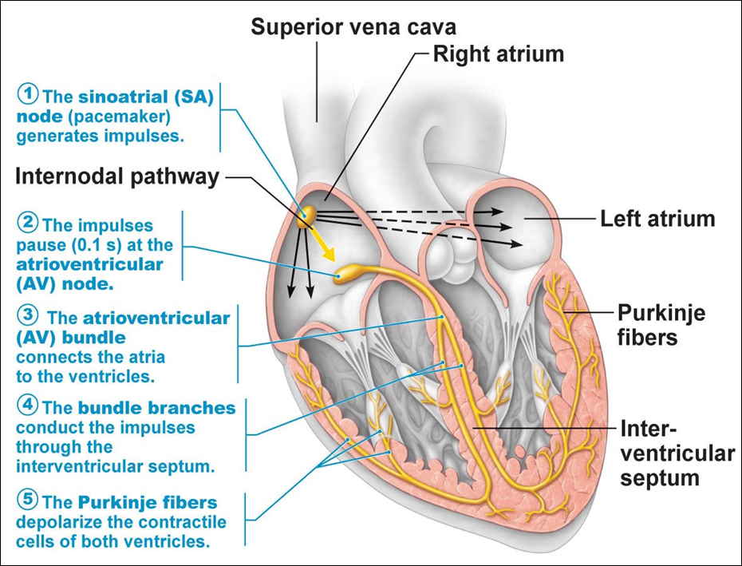
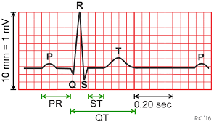
Cardiac Cycle
Location and role of the sinoatrial(SA) node:
The SA node is situated in the upper wall of the right atrium of the heart.
It is known as the ‘pacemaker’ and is responsible for setting the rhythm of the heart.
It ensures both Atria contract simultaneously.
Location and role od the atrioventricular (AV) node:
The AV node is situated at the bottom of the right atrium of the heart.
It is responsible for delaying the electrical impulses it receives from the heart.
The delay allows time for blood to empty out of the atria into the ventricles.
Purkinje fibres (also known as Purkyne)
Very fine specialised cardiac muscle fibres that rapidly transmit impulses from the atrioventricular node to the ventricles.
At rest a healthy adult heart is likely to beat at a rate of 80 to 80 beats per minute.
During each heartbeat or ‘cardiac cycle’ the heart contracts (systole) and then relaxes (diastole).
On average the cardiac cycle is repeated 70 times a minute.
Stages of the cardiac cycle:
Atrial systole - contraction of the right and left atria.
Ventricular systole – contraction of ventricles.
Complete cardiac diastole - relaxation of the atria and ventricles
An electrocardiogram (ECG) trace shows the spread of the electrical signal generated by the SA node as it travels through the atria, the AV node and the ventricles. A normal ECG can be see in the diagram on the right – it shows five waves named P, Q, R, S and T.
What does the ECG tell us about what is happening in the heart?
The waves represent the electrical activity of the heart.
The different sections represent different activities within the heart.
The P wave at the beginning shows the atrial contraction.
The QRS complex shoes the ventricular contraction (systole)
The T wave shows the ventricles relaxing (diastole)
If the waves are disordered or out of rhythm, the ECG indicates which part of the heartbeat is problematic.
A normal ECG trace
Exam Tip:
Make sure you learn the position of the SA an AV nodes and the Purkinje fibres so you can label them on a diagram of a heart.

Slide 5
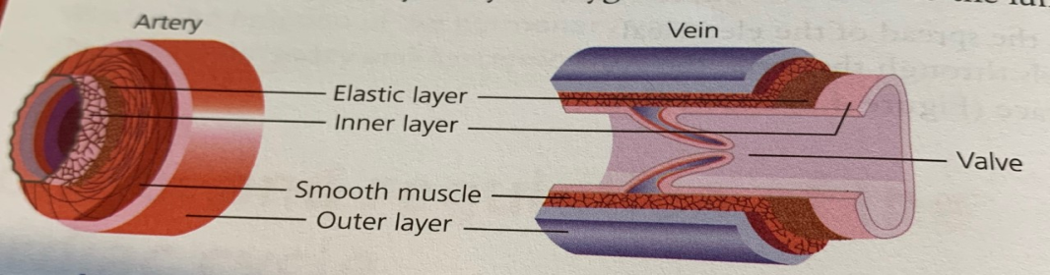
Types, structure and functions of blood vessels.
Comparing arteries and veins
Exam Tip:
Learn the differences between the three types of blood vessels to ensure that you are able to describe them and you can label a diagram of them.
Arteries | Veins
Blood is carried away from the heart. | Blood is carried towards the heart.
The blood being carried is oxygenated. | The blood being carried away is deoxygenated.
Blood flows quickly under high pressure. | Blood flows slowly under low pressure.
Blood flows in pulses. | Blood flows smoothly with a squeezing action.
The artery walls are thick, elastic and muscular. | The vein walls are thin, with little muscle.
Arteries do not have valves except at the base of the large arteries leaving the heart. | Veins have valves to prevent backflow.
Internal diameter is small. | Internal diameter is large.
An artery cross section is round. | A vein cross section is oval.
Arteries, veins and capillaries are the three different types of blood vessels that together make up the transport system for blood.
The blood moves around the body in the following sequence:
heart
arteries
capillaries
Veins
heart
The structure of arteries and veins.
Arteries - carry blood away from the heart. Their walls consist of several layers of thick, elastic fibres and muscle.
Veins – have large internal diameters and thinner walls that arteries. The blood flowing through them is not under pressure and so veins have valves through their length. The carry deoxygenated blood back to the lungs.
Capillaries – are the smallest blood vessels and have walls made of single a single layer. The thin walls of capillaries allow the exchange of water, oxygen, carbon dioxide, nutrients and waste between blood and the surrounding tissues.
Formation of tissue fluid and lymph
Lymph passes through vessels of increasing size before returning to the blood. The lymphatic system consists of:
Lymph
Lymph vessels
Lymph nodes
Lymph organs, e.g. spleen and thymus
Bone marrow

Slide 6
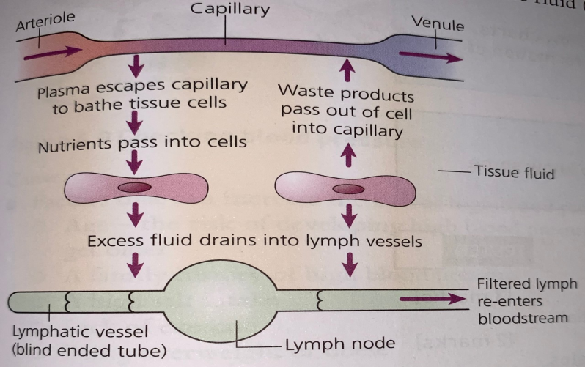

Formation of tissue fluid and lymph
Comparing plasma, tissue fluid and lymph
The role of the lymphatic system:
It is a drainage and filtration system.
It removes excess fluid from body tissues.
It absorbs fatty acids, ad transports fat into the bloodstream to be absorbed in the small intestine.
It produces white blood cells, which in turn produce antibodies.
The role of hydrostatic pressure:
Hydrostatic pressure is the pressure from heart contractions that forces water and dissolved substances in blood plasma out through capillary walls into surrounding tissues, forming tissue fluid.
Blood plasma | Tissue fluid | Lymph
Clear straw coloured liquid component of blood. | Fluid between body cells – also known as interstitial fluid. | Filtered watery fluid drained from the lymphatic system.
Contains plasma proteins, which have roles in blood clotting and supporting the immune system. | Carries nutrients and oxygen to tissue cells. | Formed from Plasma and contains white blood cells.
Osmotic regulation (control of the water content of the body, avoiding too much water entering or leaving the cells) | Is formed from filtering of blood from capillaries due to hydrostatic pressure. | Lymph is involved in the removal of wastes and infectious organisms from tissues.
Formation of tissue fluid
Exam tip:
Make sure you can compare the differences and similarities between blood plasma, tissue fluid and lymph. Use the table above to help you!
Blood Proteins (also called plasma protein)
The most prevalent plasma proteins are albumins, which are main contributors to the thickness/viscosity of plasma and to osmotic pressure. The pressure retains fluid within blood vessels – it is the opposite force to hydrostatic pressure. If plasma protein levels fall, the osmotic pressure also falls and fluid leaking from the bloodstream can accumulate in the tissues causing oedema.
The second most prevalent group are the globulins, which include immunoglobulin/antibodies. These are protective proteins essential for the body’s immune response and are made by lymphocytes (white blood cells).
Fibrinogen is a third type of plasma protein, which has a role in blood coagulation and clotting.
Odema – build up of fluid in the body that causes the affected tissue to become swollen. The swelling can occur in one particular part of the body or may be more general, depending on the cause.
Blood coagulation or clotting – important process that prevents excessive bleeding when a blood vessel is injured. Platelets and proteins in the plasma work together to stop bleeding by forming a clot over the injury.

Slide 7
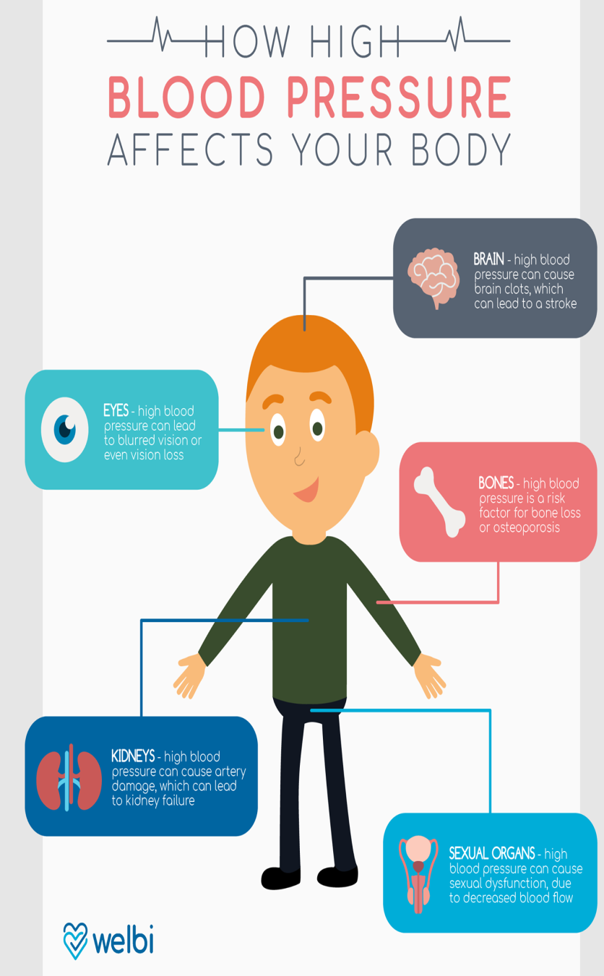
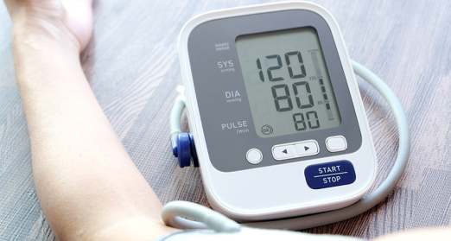
Cardiovascular malfunctions
Hypertension (high blood pressure)
Factors that can increase the risk of high blood pressure:
Age – as you get older, the risk increases.
Family history – if it runs in the family people are more susceptible to it.
High salt intake (adding to foods, too many processed food and snacking on crisps and nuts).
Lack of exercise.
Being overweight / obese.
Smoking.
Regularly drinking large amounts of alcohol.
Conditions that can cause high blood pressure include:
Kidney Disease.
Diabetes.
Hormone problems – for example, an under active or over active thyroid.
Monitoring, treatment and care needs:
Blood pressure taken regularly to monitor it.
Impact on lifestyle: changes in diet to balanced diet with low fat and salt; regular exercise, reduced alcohol consumption, stopping smoking, at least 6 hour of sleep per night and reducing stress.
Medication: Doctors may recommend taking one or more medications to keep blood pressure under control. These are normally taken once a day. Common medications for high blood pressure are ACE inhibitors, which lower blood pressure and beta-blockers, which slow the heart rate.
Impacts: Hypertension can lead to an increased risk of coronary heart disease, strokes and kidney disease.
Symptoms and effects:
A rough guide, ideal blood pressure is considered to be between 90/60mmHg and 120/80mmHg. High blood pressure is anything around 140/90mmHg or higher.
Hypertension doesn’t really have noticeable symptoms.
The biology bit!
Blood pressure is recorded with two numbers. The systolic pressure (higher number) is the force at which your heart pumps blood around the body.
Diastolic pressure (lower number) is the resistance to the blood flow in the blood vessels.
Both are measured in millimetres of mercury (mmHg).
High blood pressure damages the blood vessels.
Checking blood pressure.
Exam Tip:
PIES Effects – can help you remember the impacts on individuals of having an illness.
P (Physical)
I (Intellectual)
E (Emotional)
S (Social)

Slide 8
Coronary Heart Disease
Medication:
Nitrates relax the coronary arteries and allow more blood to reach the heart – used to treat or prevent angina.
Statins – cholesterol reducing medication.
Antiplatelet medicines, like aspirin or clopidogrel and anticoagulant medicines make the blood less likely to form clots and reduce the risk of having a heart attack.
ACE inhibitors – lower blood pressure and are used if someone has had a heart attack.
Symptoms & Effects:
Angina:
Breathlessness
Nausea
Dizziness
Chest pain
Feeling of tightness in the chest that might spread to the arms, neck and jaw.
Heart Attack: (myocardial infarction)
Light headedness
Feeling weak
Sweating
Shortness of breath
Chest pain; radiating from chest to jaw, neck, arms and back.
Causes:
Coronary heart disease is cause by a build up of fatty deposits on the walls of arteries around the heart.
Risk of this developing is significantly increased by lifestyle factors such as smoking, drinking alcohol, lack or regular exercise and obesity.
Or an individual may have high cholesterol, high blood pressure or diabetes.
Age, genes, and gender can also influence the likelihood of developing heart disease.
Surgical Procedures:
Angioplasty passes a tiny deflated balloon in to a narrow artery and then inflates it which pushes the artery open. Sometimes a stent or mesh tube is inserted to treat narrow arteries.
Coronary artery heart bypass – the graft surgery is to bypass the narrow coronary arteries to improve the flow of blood to the heart.
Coronary Heart Disease – can’t be cured but treatment can help manage symptoms and reduce the chance of problems like heart attack.
NB: PIES Impact on being able being able to complete daily living tasks, and emotional and social impacts.
Monitoring, treatments and care needs:
Blood tests can check the levels of certain fats, cholesterol, sugar and proteins in the blood.
An electrocardiogram (ECG) measures the electrical activity of the heart and can show any damage to the heart muscles or signs of coronary heart disease. (CHD)
Lifestyle changes – such as reducing alcohol intake, less fat salt and sugar in the diet, regular moderate exercise etc.
Biological Explanation:
Walls of arteries become blocked with fatty deposit atheroma – the process is called atherosclerosis
When arteries become blocked completely blocked it can cause a heart attack, which can permanently damage the heart muscle and be fatal if not treated immediately.

Slide 9
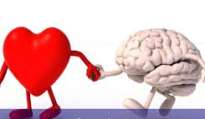
LO1 TEST YOURSELF!
REVISION ACTIVITIES:
Draw a flow chart to represent the flow of the blood through the heart.
Copy an ECG image and label P,Q,R,S and T waves and explain what they mean
Describe the structure of an artery.
Describe the structure of a vein.
Describe the functions of arteries, veins and capillaries.
Give three main differences between veins and arteries.
Identify three roles of the lymphatic system.
What is the difference between lymph and interstitial (tissue) fluid?
Name the plasma protein (blood protein) that helps blood clot.
Describe two other types of plasma proteins
Would blood pressure measurement 143/91 be considered low, normal or high? Give a reason for your answer.
Describe the impact of hypertension on an individual who has the condition.
Identify three lifestyle changes that may be needed for someone who has been diagnosed with angina.
Describe three symptoms of a person having a heart attack.
Describe three possible treatments for someone who has had a heart attack.
Describe social and emotional impacts on an individual with coronary heart disease.
Make your own drawings of veins and arteries and label them, then add how their structure enables them to carry out their function.
Divide a sheet of paper into two columns. Draw a flow charts based on the ‘Formation of tissue fluid’ image with the processes involved in the formation of tissue fluid.
Common Exam Errors
Mixing up the veins and arteries – make sure you know the difference!
Mixing up lymph and tissue fluid – make sure you know the difference!
Thinking that having medical treatment is the main impact of having coronary heart disease – you need to know and comment on the social and emotional impacts too.

